Slide 1



Humor kot začimba pri poučevanju
Miha Kos
Hiša eksperimentov
© Božo Kos

Slide 2
Življenjepis
Rodil sem se v Mariboru
Osnovna šola Prule
Gimnazija Poljane
FMF
Amerika
Revija Petka
Hiša eksperimentov

Slide 3


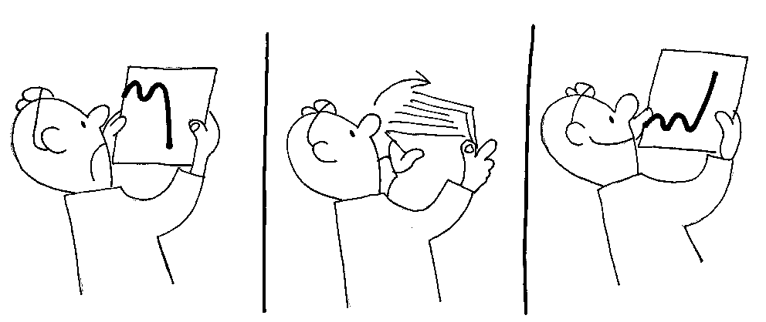
Smeh, nasmeh, humor
  jok (prvi signal dojenčka)
  smeh (razvil se je iz signala: Je nevarnost
  a ni nevarna, ker te čuvam)
  smeh pozneje postane signal za igro (in raziskovanje!!!)
© Božo Kos

Slide 4

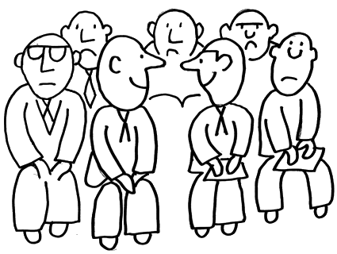
Smeh, nasmeh, humor
  nasmeh (krepitev socialnih vezi)
  humor (način privabljanja nasmeha in smeha)
© Božo Kos

Slide 5
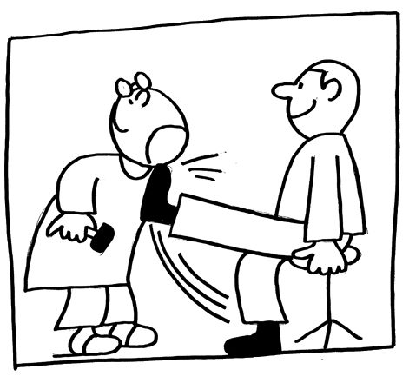
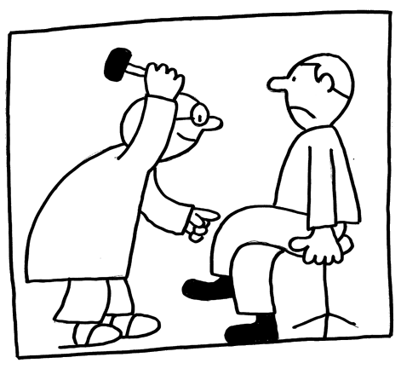
Zakaj humor pri poučevanju?
sprostitev
lažja vzpostavitev povezave učitelj-učenec
markerji za pomnenje
zdravje
  sproščanje endorfina (endomorfin) in rastnega hormona
  izboljšuje imunski sistem, zmanjševanje bolečin, zmanjševanje alergoloških pojavov, izboljševanje splošnega počutja, zmanjšuje stres, pomaga kontrolirati sladkorno bolezen (zmanjševanje sladkorja v krvi)
© Božo Kos

Slide 6
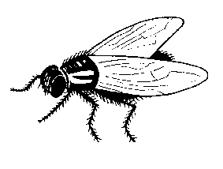
Tehnike humorja
ilustrativni primeri:
  Velikost vodikovega jedra je 10⁻¹⁰ m
  Velikost protona je 10⁻¹⁵ m
  Če je atom velik kot tale soba, kako veliko je jedro?
    Kot mušji kakec.
    in
  Na konzervah v trgovinah bi moralo pisati: v tej konzervi je 99,999% praznega prostora!

Slide 7
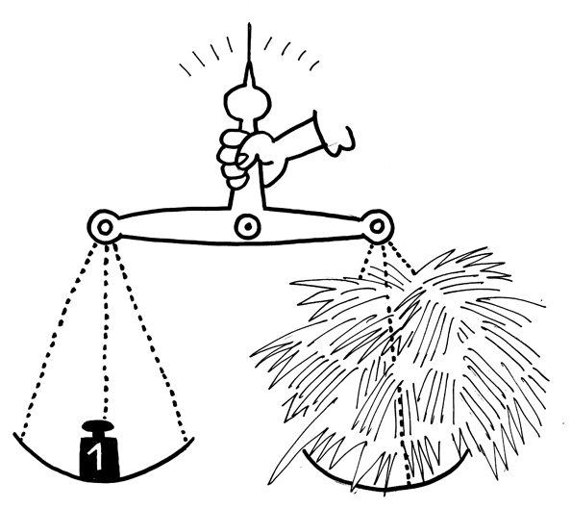


ilustrativni primeri:
  Tehtnica, železo, slama
  Jadrnica in pihanje
© Božo Kos
© Božo Kos

Slide 8
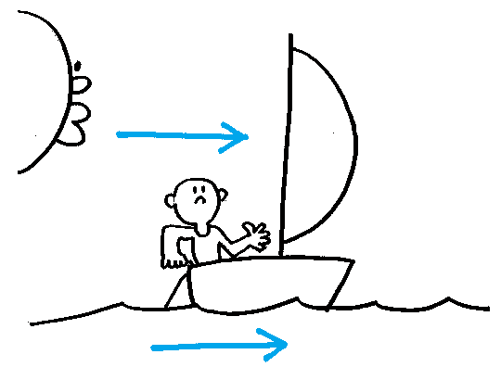
ilustrativni primeri:
  Jadrnica na reki
  Radioaktivni razpad in eksponentna rast, lokvanj, pregibanje papirja
  Ekvator okrog Zemlje
  Lovec na medvede
  Vlak iz Moskve v Vladivostok
© Božo Kos

Slide 9
Tehnike humorja
Šaljivi teksti:
  Bell Laboratoriji dokazali obstoj srkalcev teme
  Paradoks mačke in kruha z maslom
  Prepovejmo Dihidrogen monoksid
  ...
  www.google.com (humour, physics)

Slide 10
Tehnike humorja
Šale:
  Avtomobilski prekršek
  Opeka s hiše
  Ropotanje koles pri vlaku
  ...
  www.google.com (humour, physics)

Slide 11
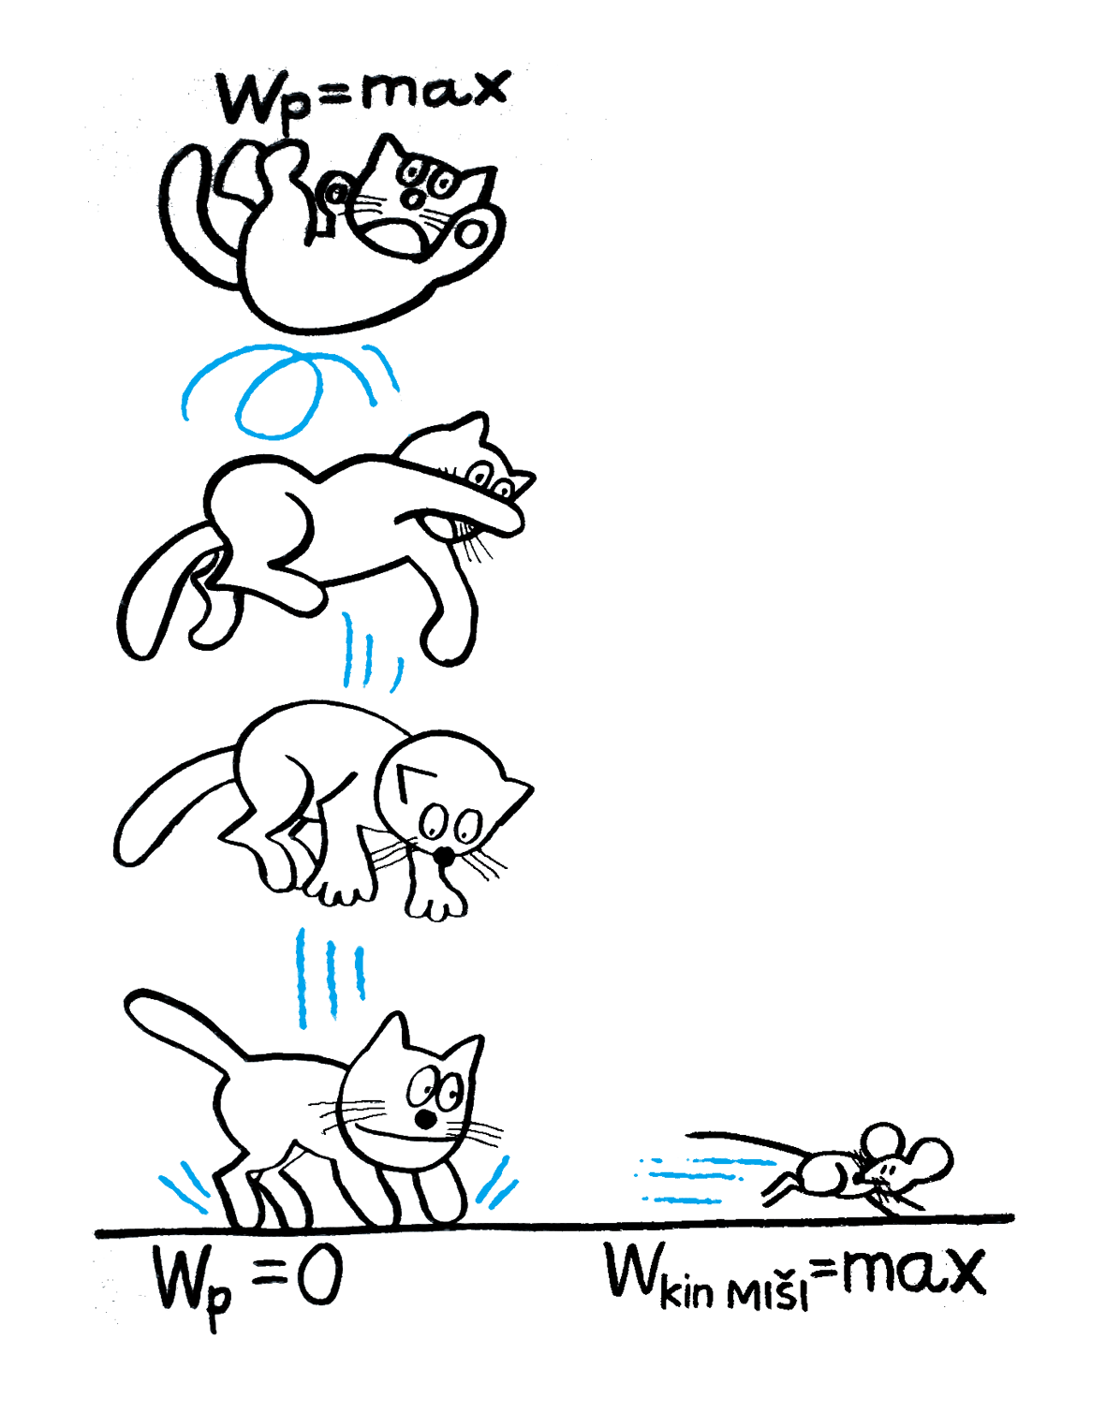
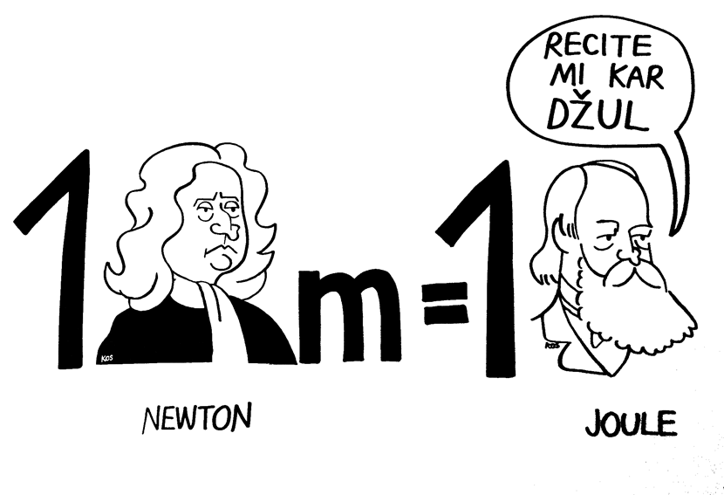
Tehnike humorja
risbe - ilustracije:
© Božo Kos
© Božo Kos

Slide 12
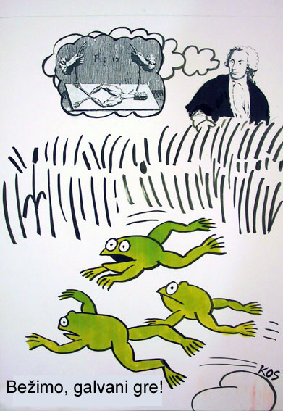
Tehnike humorja
risbe - ilustracije:
© Božo Kos

Slide 13
Tehnike humorja
stripi:
primer:
© Božo Kos

Slide 14
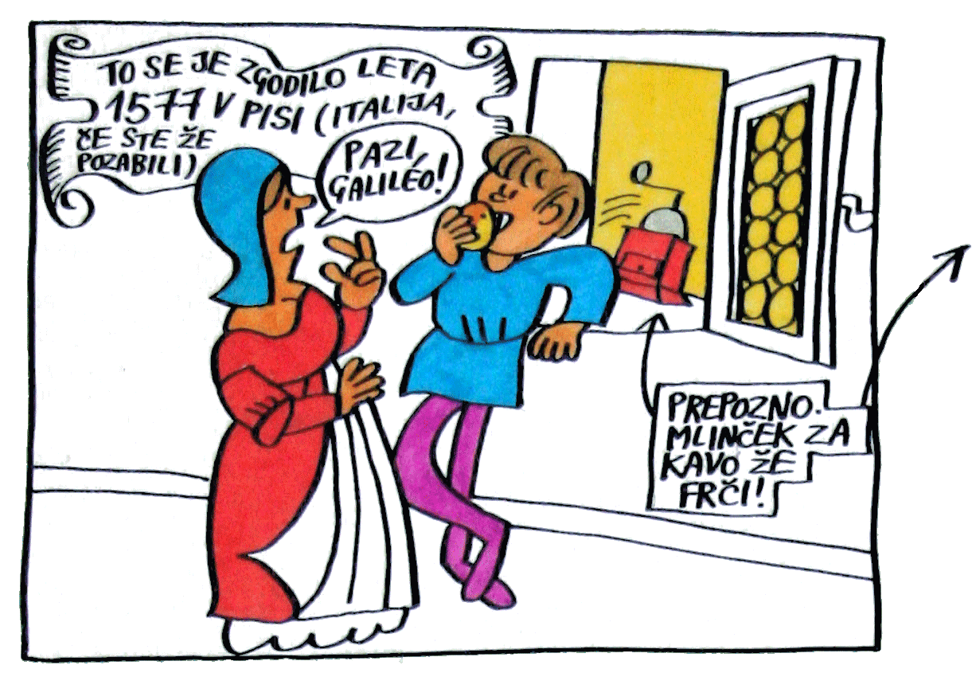

Slide 15
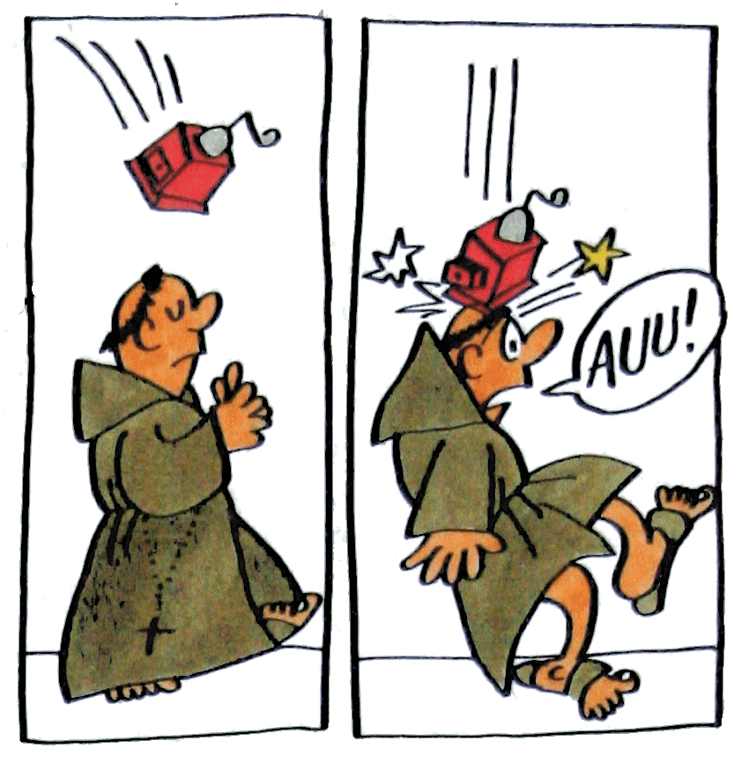
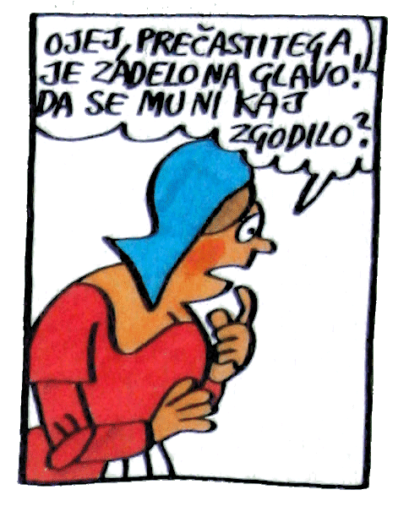

Slide 16
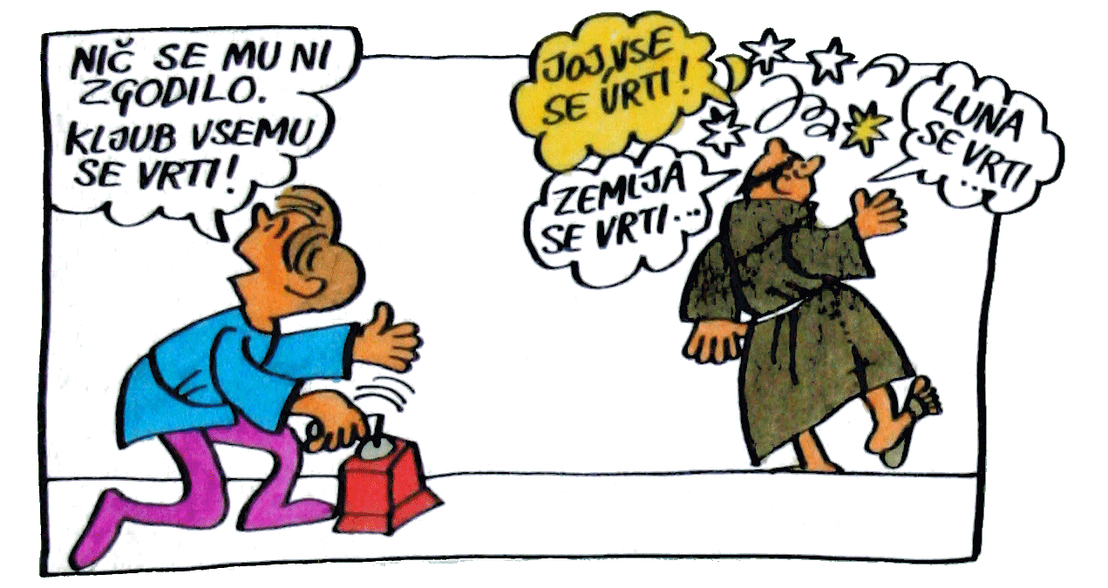

Slide 17
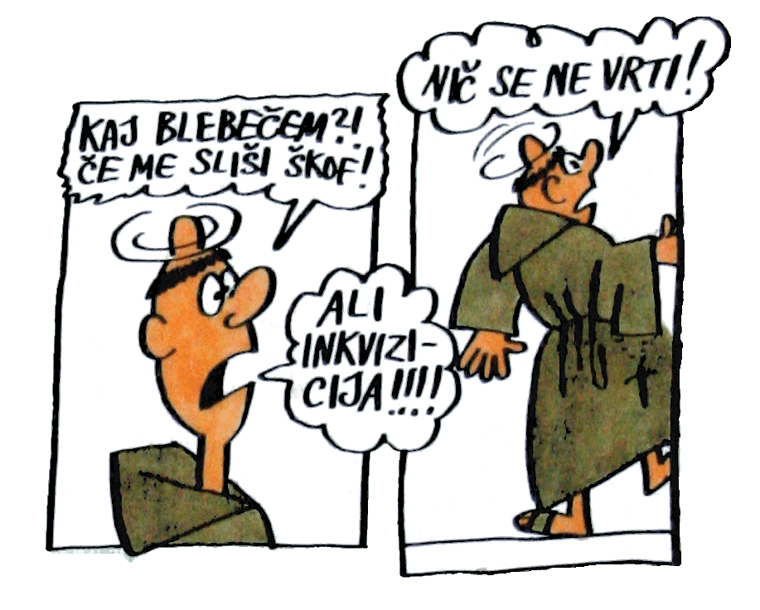

Slide 18
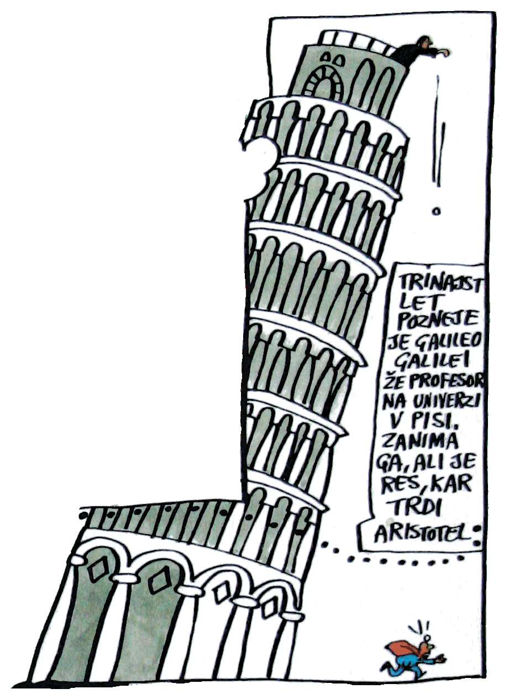

Slide 19
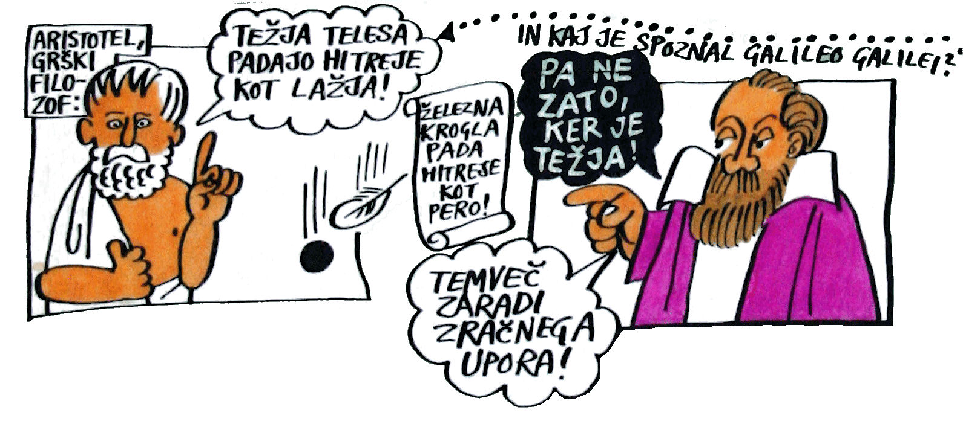

Slide 20
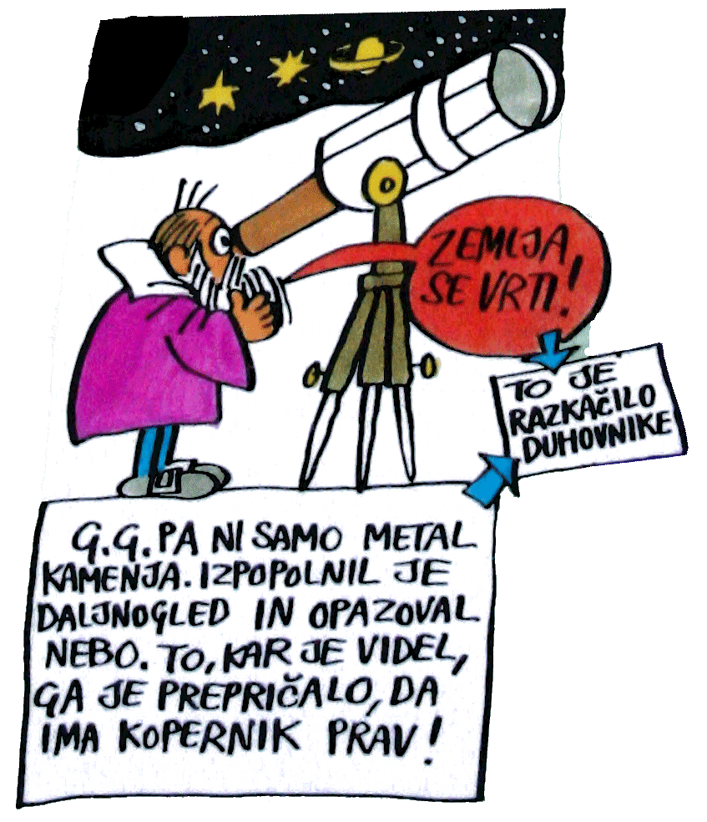
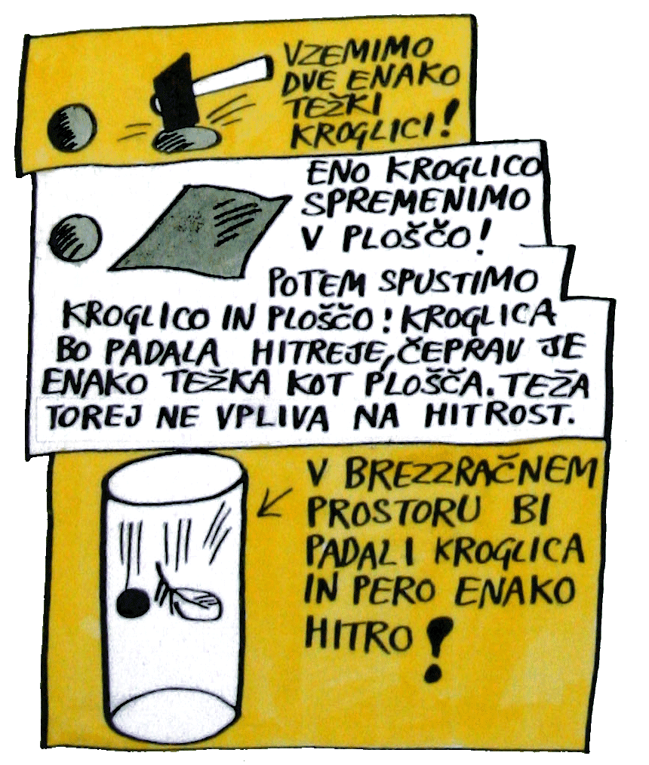

Slide 21
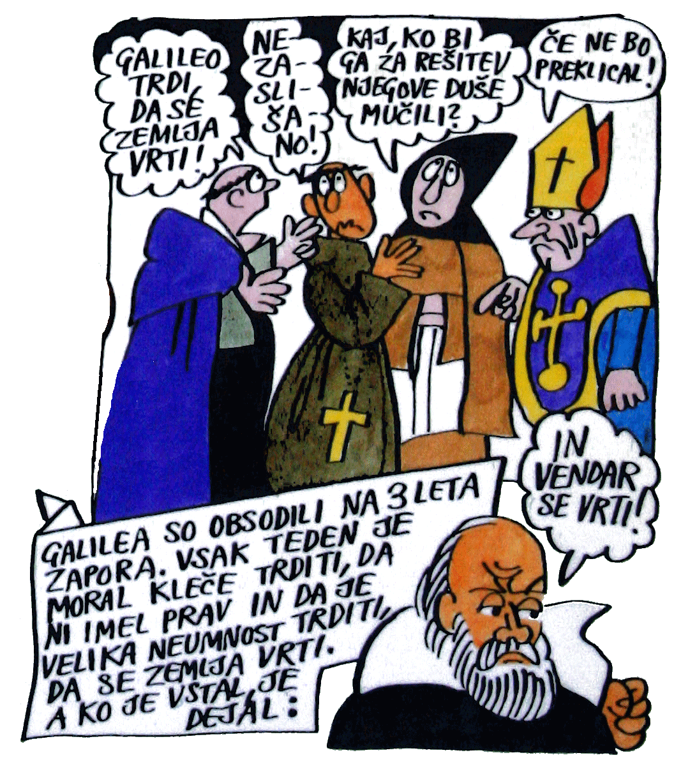
© Božo Kos

Slide 22
Tehnike humorja
poskusi, “metafizika” in “čarovnije”

Slide 23
© Hiša eksperimentov

Slide 24
Strahovi
Izguba kredibilnosti, ker nisem resen.
“Eni res znajo vice pravit, jaz pa ne!”
“Vse šale pozabim!”
Morda ne bodo razumeli šale.
Kje je meja med duhovitim in banalnim?

Slide 25

The most exciting phrase to hear in science, the one that heralds new discoveries, is not "Eureka!" ("I found it!") but rather "hmm....that's funny..."
-- Isaac Asimov
In science one tries to tell people, in such a way as to be understood by everyone, something that no one ever knew before. But in poetry, it's the exact opposite. -- Dirac, Paul Adrien Maurice
You do not really understand something unless you can explain it to your grandmother. -- Albert Einstein
It ain't what you don't know that gets you into trouble. It's what you know for sure that just ain't so. – Mark Twain
There is only three certainties in this life. The laws of physics, the laws of murphy and death. – Mark Twain

Slide 26

Literatura
Desmond Morris, The Naked Ape
Eurekalert. 7 March 2005. Press Release: Laughter helps blood vessels function better.
www.eurekalert.org
Clark A, Seidler A, Miller M. Inverse association between sense of humor and coronary heart disease. Int J Cardiol 2001; 80(1): 87-88.
Hearty laughter: Health benefits of seeing the funny side. NHS Electronic Library for Health. 16 January 2003.
www.nelh.nhs.uk
Berk L S, Felten D, Tan S et al. Modulation of neuroimmune parameters during the eustress of humor-associated mirthful laughter. Altern Ther Health Med 2001; 7: 62-72, 74-76.
Dillon KM, Minchoff B, Baker KH. Positive emotional states and enhancement of the immune system. Int J Psychiatry 1985-1986; 15(1): 13-18.
Bennett MP, Zeller JM, Rosenberg L et al. The effect of mirthful laughter on stress and natural killer cell activity. Altern Ther Health Med 2003; 9(2): 38-45.
Takahashi K, Iwase M, Yamashita K et al. The elevation of natural killer cell activity induced by laughter in a crossover designed study. Int J Mol Med 2001; 8(6): 645-650.
Laughter tested as pain therapy for children. Press release: Rx Laughter. 21 February 2002.
Weisenberg M, Tepper I, Schwarzwald J. Humor as a cognitive technique for increasing pain tolerance. Pain 1995; 63(2): 207-212.
Laughter eases hospital pain. BBC News. 21 February 2002.
Ditlow F. The missing element in health care. Humor as a form of creativity. J Holist Nurs 1993; 11(1): 66-79.
Kimata H. Effect of humour on allergen-induced wheat reactions. JAMA 2001; 285(6): 738.
Kimata H. Laughter counteracts enhancement of plasma neurotrophin levels and allergic skin wheal responses by mobile phone-mediated stress. Behav Med 2004; 29(4): 149-152.
Kimata H. Differential effects of laughter on allergen-specific immunoglobulin and neurotrophin levels in tears. Percept Mot Skills 2004; 98(3 Pt 1): 901-908.
Foley E, Matheis R, Schaefer C. Effect of forced laughter on mood. Psychol Rep 2002; 90(1): 184.
Berk LS, Tan SA, Fry WF et al. Neuroendrocrine and stress hormone changes during mirthful laughter. Am J Med Sci 1989; 298(6): 390-396.
Hayashi K, Hayashi T, Iwanaga S et al. Laughter lowered the increase in postprandial blood glucose. Diabetes Care 2003; 26(5): 1651-1652.

